Slide 1

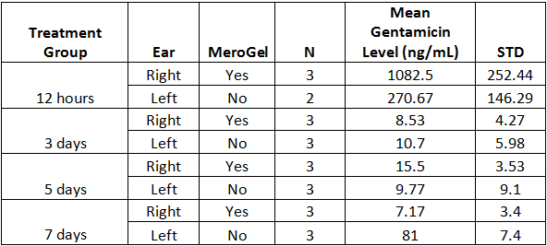
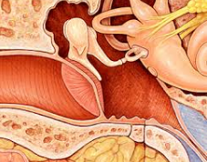
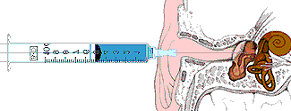
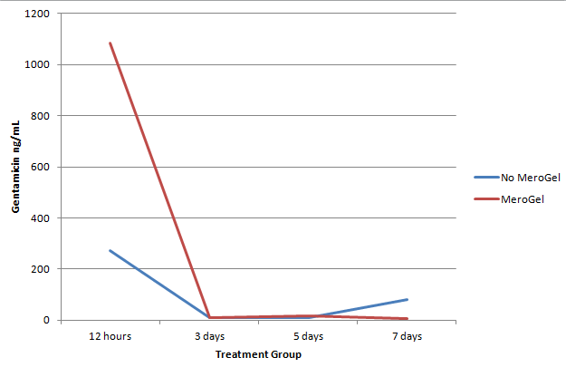
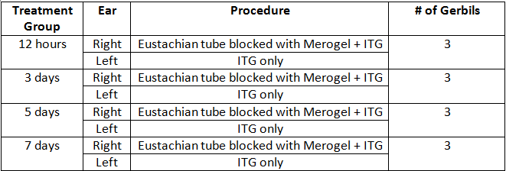
Effects of blocking the eustachian tube on gentamicin in the inner ear
Stephen Vong¹, Elvira Buijs, M.D.², Steven Tinling, Ph.D. ², and Hilary Brodie, M.D., Ph.D. ²
¹UC Davis School of Medicine, ²UC Davis Department of Otolaryngology
Introduction
Meniere’s Disease (MD): An inner ear disorder defined as vertigo, tinnitus, hearing loss, and fullness of the ear.
Intratympanic Gentamicin (ITG) Treatment: Treatment of choice for controlling intractable vertigo in MD.
  Mechanism of action: Gentamicin causes vestibular ototoxicity, thereby decreasing episodes of vertigo.
Meta-analyses: After ITG treatment, 10-30% of individuals do not achieve complete or substantial vertigo control.
  Hypothesis: Additional gentamicin is unable to penetrate through the round window because it escapes via the eustachian tube once the patient sits upright after ITG treatment.
Purpose: Examine the effects of blocking the eustachian tube on gentamicin concentration in the inner ear and if the concentration changes depending on varying time points.
Results
Table 2. Mean gentamicin concentration by treatment group.
Figure 1. Gentamicin concentration in MeroGel versus no MeroGel gerbils across treatment groups.
Within Group Analysis:
  12 hour Group: Gerbils with MeroGel had significantly higher Gentamicin than the no MeroGel group (p=0.18).
Between Groups Analysis:
  MeroGel Group: 12 hour group with significantly higher gentamicin than 3 day (p<0.001), 5 day (p<0.001), and 7 day (p<0.001).
  No MeroGel Group: 12 hour group with significantly higher gentamicin levels than 3 day (p=0.028), 5 day (p=0.028).
Conclusions
Findings showed increased gentamicin absorption into the perilymph of the inner ear in in the 12 hour treatment group.
Non-significant results for 3 days, 5 days, and 7 days may be due to dissolved MeroGel.
Results of this study have shown a promising and novel method to increase gentamicin diffusion through the round window and possibly improved efficacy of ITG treatment.
Future Study: We are planning to repeat the experiment with 10 gerbils for the 12 hour treatment group to verify our findings.
References
Chia, SH, Gamst, AC, Anderson, JP, and Harris, JP. (2004). Intratympanic Gentamicin Therapy Meniere’s Disease: A Meta-analysis. Oto Neurotol, 25(4), 544-52.
Cohen-Kerem, R, Kisilevsky, V, Einarson, TR, Kozer, E, Koren, G, and Rutka, JA. (2004). Intratympanic gentamicin for Meniere’s disease: a meta-analysis. Laryngoscope, 114(12), 2085-91.
Hoffer, ME, Allen, K, Kopke, RD, Weisskopf, P, Gottshall, K, and Wester, D. (2001). Transtympanic versus sustained-release administrations of gentamicin: kinetics, morphology, and function.
Huon, LK, Fang, TY, and Wang, PC. (2012). Outcomes of intratympanic gentamicin injection to treat Meniere’s disease. Otol Neurotol, 33(5), 706-14
MacKeith, SA, Whiteside, OJ, Mawby, T, and Bottrill, ID. (2014). Middle ear gentamicin-soaked pledgets in the treatment of Meniere’s disease. Otol Neurotol, 35(2), 305-9.
Pearson WP, Brackmann DE. Committee on hearing and equilibrium: Committee on Hearing and Equilibrium guidelines for the diagnosis and evaluation of therapy in Meniere’s disease. Otolaryngol Head Neck Surg 1995;113:181–5.
Pearson BW, Brackmann DE. Committee on Hearing and Equilibrium guidelines for reporting treatment results in Meniere’s disease. Otolaryngol Head Neck Surg 1985;93: 579–581.
Pullens, B, and van Benthem, PP. (2011). Intratympanic gentamicin for Meniere’s disease or syndrome. Cochrane Database of Syst Rev, 3, CD008234.
NIDCD. (2010). Meniere’s disease. Retrieved June 14th, 2016 from https://www.nidcd.nih.gov/health/balance/pages/meniere.aspx.
Xu, L, et al. (2010). A controlled and sustained local gentamicin delivery system for inner ear applications. Otol Neurotol, 31(7), 1115-21.
Materials and Methods
Table 1. Treatment groups, procedures, and subjects.
Collection and Analysis:
  Perilymph surgically collected and samples stored at -80C.
  Perilymph samples analyzed through LC-MS for gentamicin concentration.
Statistics:
  Independent t-test: Differences in gentamicin level within a treatment group.
  One-way ANOVA: Differences in gentamicin level between a treatment group
Acknowledgements & Contact
This study was supported by the UC Davis Department of Otolaryngology and UCDSOM Scholarly Project Option (SPO).
For more information, please contact Stephen Vong at sevong@ucdavis.edu.

